Slide 1





Bertelsmann Scholarship

Slide 2


Who are your contacts?
The Bertelsmann University program leads
Laura Echterhoff
Scholarship Lead & Program Manager
laura.echterhoff@bertelsmann.de
Jenny Meindel
Tech & Data Learning Lead
jennifer.meindel@bertelsmann.de
For further information, please visit: www.bertelsmann-university.com

Slide 3

Bertelsmann Scholarship
What´s new? New content & individualized learning based on skill profiles
Bertelsmann Scholarship
1,500 scholarships
Target group: all employees
Content focus: AI Fluency & Transformation
400 scholarships
Target group: all employees
Content: AI Engineering, Agentic AI, AI Security & Product Management Nanodegrees
250 scholarships
Target group: all employees
Content: Agentic AI Foundations
Personal AI agent for targeted skill-based learning
New content/ Nanodegrees
New content/ course

Slide 4

Bertelsmann Scholarship
Provider Overview
Who should attend
All employees who want to develop skills in AI fluency and transformation
All employees who want to expand their AI Engineering, Agentic AI, AI Security or Product Management skills
Employees who want to get an introduction to Agentic AI
Content
Explore tailored AI content using your personal AI agent for targeted skill-based learning
+ full catalog access
5 Nanodegrees: AI Engineering, Agentic AI, Product Management
& Cybersecurity.
Complete the first ND and get access to the entire Udacity catalog
Course: Agentic AI Foundations
new
new
new
Course Style
Benefit from a personal AI agent and get access to video lectures, readings, quizzes, and assignments
Video lessons, short quizzes, and complete comprehensive real-world projects.
Real world cases delivered via short videos, interactive exercises, and exchange forums
new
Duration
12 months / self-paced
7 months / self-paced
4 weeks/ self-paced
Engagement / Interactivity
Inactive users may be replaced with waitlisted applicants
Inactive users are removed after the activation deadline expires
Highly interactive program in a Bertelsmann-only cohort
Certificate
Get certificates from renowned universities and institutions
Get an industry-recognized Udacity certificate
Get a renowned Harvard Online certificate
1,500 seats
400 seats
250 seats

Slide 5
Bertelsmann Scholarship
Timeline and milestones
Application Phase:
Oct 1 – Nov 30
Employees can apply for
a Coursera, Udacity or Harvard Online seat
Announce-ment:
Mid of Jan
Applicants will receive notification of their application outcome via email
Coursera: January 13 – December 31, 2027
Start: Skill reflection
Participants reflect on their skills with a personalized AI agent
Subsequent: Start Coursera 1-year license
Participants begin skill-based learning journey with AI agent to unlock individual learning recommendations
Finish: Measure skill progress
Participants repeat the skill reflection to validate their development
Udacity: January 13 – August 15, 2027
5 different Nanodegree Programs.
Complete one and access the entire Udacity catalog
Harvard Online: Cohort 1:
Jan 13 – Feb 10
Harvard Online: Cohort 2:
Apr 7 – May 5
Harvard Online: Cohort 3:
Sep 1 – 29
Okt
Nov
Dec
Jan
Feb
Mrz
Apr
May
Jun
Jul
Aug
Sep
Oct
Nov
Dec

Slide 6
Bertelsmann Scholarship
Coursera in more detail: Overview
Who should attend
All employees who want to develop skills in AI fluency and transformation through a personal AI agent for targeted skill-based learning
Content
12-months unlimited access to nearly all learning content on the Coursera platform
Coursera courses include recorded auto-graded and peer-reviewed assignments, video lectures, and community discussion forums
Browse and preview the full Coursera catalog here.
See more on next slide
Learning Experience & Engagement / Interactivity
Personal AI agent for targeted skill-based learning
Learners can learn at their own pace with bite-sized sessions and a self-paced learning model
Short lectures and lessons, so learners can make meaningful progress in just a few minutes a day
The time varies by each course. Courses typically take 1–6 weeks to complete, with an average total learning time of 20 hours
Highest flexibility in picking learning content
Inactive users may be replaced with waitlist participants
Certificate
Learners will receive a shareable electronic course certificate upon completion.
Duration
January 13 – December 31, 2027
Access
100% Self-nomination

Slide 7

Bertelsmann Scholarship
Coursera in more detail: Personal AI agent enables skill-based learning
Target group: Employees
AI skill framework as conceptual backbone
Personal AI agent guides the individual learning journey
  Goal: Understand which skills are relevant for applying AI on different competence levels.
  AI skill set: Developed based on research, market data and expert knowledge.
  3 proficiency level: Each skill is defined across three levels allowing you to start where you are.
  Role-based focus: Learn the skills you need to use AI effectively based on your job requirements.
1
2
3
4
REFLECT
Evaluate AI skill set through adaptive survey
TARGET
LEARN
Choose suggested courses to develop towards target
CHECK
Repeat skill reflection
to measure
success
Receive feedback and learning target
You · 1
0 1
Target · 2
2 3
Powered by
AI skill domains
Transformation & People
AI Literacy & Judgment
AI Build & Operate
AI Governance

Slide 8
Bertelsmann Scholarship
Coursera in more detail: Personal AI agent enables skill-based learning
Target group: HR
AI skill framework as conceptual backbone
Personal AI agent guides the individual learning journey
  Established AI user profile based on research, market data and expert knowledge.
  Defined a unique skill set for each user profile, reflecting role-based skill requirements.
  Covered a broad range of relevant AI topics, including Transformation & People, AI Literacy & Judgment, AI Build & Operate, and Governance.
1
2
3
4
REFLECT
Evaluate AI user profile & current skill level through survey
TARGET
LEARN
Choose suggested courses to develop towards target
CHECK
Repeat skill reflection
to measure
success
Receive feedback and learning target
You · 1
0 1
Target · 2
2 3
Powered by
Details next page
User profile
Profile description
AI skill set
User
Apply AI: Uses approved AI tools to perform individual work tasks effectively and responsibly, including prompting, critical evaluation of outputs, and compliance with AI policies.
Unique skill set
Power user
Scale AI: Applies AI at an advanced level to improve workflows, creates reusable AI assets such as prompts, GPTs or automations, and enables others to adopt proven practices.
Unique skill set

Slide 9
Deep-dive: AI skills framework for personal AI agent –
Skills and levels for AI user profiles in scope
Target group: HR
Skill¹⁾ | Manager | User | Power user | Executive | Builder | Platform Enabler
TRANSFORMATION & PEOPLE – DEFINE
AI Value & Use Case Identification | E | B | E | A
Human-AI Workflow Redesign | E |  | A | B
Enablement, Influence & Adoption | E |  | E | E
AI LITERACY & JUDGMENT – DISCOVER
AI Fundamentals | A | A | E | A | E | A
Prompting & Context Design | A | A | E | A | E | A
Critical Evaluation | A | A | E | A | E | A
AI BUILD & OPERATE – DELIVER
AI Solution Design |  | B | A |  | A
AI Solution Engineering |  |  | A |  | E | E
AI Operations & Security |  |  | A |  | E | E
GOVERNANCE – DE-RISK
AI Governance & Compliance | A | A | A | A | A | A
B = Basic proficiency level
A = Advanced proficiency level
E = Expert proficiency level
1) Skill order reflects the sequence of the AI value creation process.

Slide 10

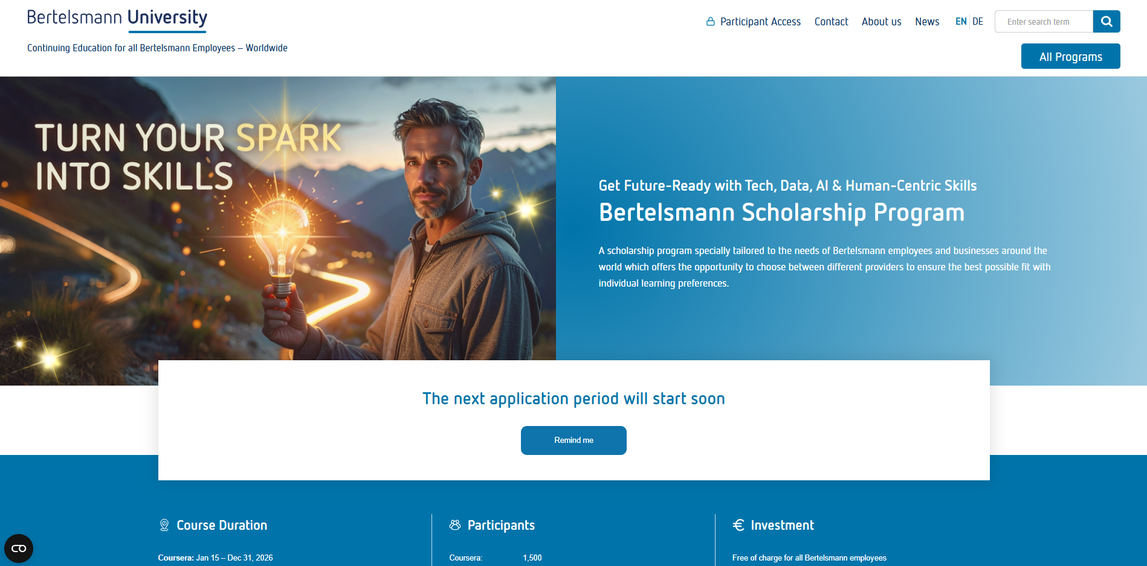
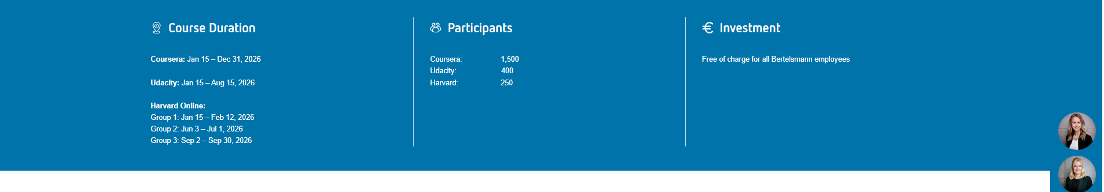
Bertelsmann Scholarship
Udacity in more detail: New course content and stronger development / expert focus
2026
2027
Oct
Nov
Dec
Jan
Feb
Mar
Apr
May
Jun
Jul
Aug
Application Period
Oct 1 – Nov 30
Nanodegree Program
Jan 13 – August 15, 2027
(2 – 4 hours/ week)
Updated in 2026: Product Manager
Start
Oct 1
Updated in 2026: AI Programming with Python
Selection Process &
Announcement of Scholarship Participants
pre-reqs required
New: Microsoft Agentic AI
pre-reqs required
New: Anthropic Engineer
pre-reqs required
Brand new: AI Security Engineer
pre-reqs required
Beginner
Intermediate
Advanced
400 seats

Slide 11
Bertelsmann Scholarship
Harvard Online in more detail: New course Agentic AI Foundations
Who should attend
Employees who want to gain a practical, non-technical understanding of Agentic AI and learn how AI agents can create value in business.
What you learn
Get a detailed overview at the Harvard Online program Syllabus: Agentic AI Foundations
Learning Experience & Engagement / Interactivity
Highly interactive program in a Bertelsmann-only cohort
Short video lectures from Harvard faculty and guest experts focusing on real-world cases
Frequent opportunities to collaborate and exchange ideas with cohort peers
Practical, non-technical exploration of Agentic AI and its business impact
Certificate
Learners will receive a Harvard Online Certificate
Dates & Duration (tbd)
Group 1: January 13 – February 10, 2027
Group 2: April 7 – May 5, 2027
Group 3: September 1 – 29, 2027
4 weeks at 2-3 hours / week
Access
100% Self-nomination

Slide 12


Bertelsmann Scholarship
Application process
When to apply
Application period: Oct 1 – Nov 30, 2026
Who should apply?
Bertelsmann employees who want to advance their future-ready skills
How to apply
The application has to be made proactively via application forms.
https://www.bertelsmann-university.com/
scholarship-program.html
(Application go-live on October 1, 2026):
What’s requested?
Choice of provider
Personal data (Employees should provide their Levio employee-ID)
Motivational questions

Slide 13
Bertelsmann Scholarship
Selection process
Selection Criteria
Divisional Distribution
Diversity (Gender, Countries)
Motivational Questions
Who will do the Selection
Bertelsmann University Team will apply the selection criteria

Slide 14
Bertelsmann Scholarship
How HR should support the initiative to close the group wide skills gap
Bertelsmann University
Info & Marketing Package
FAQ
Infographic
Digital Flyer
Printed Poster
Monitor Slides (digital poster)
Lock Screen Slides
…
Go-live & further Communication
BeNet Articles
BCP Articles & Postings
Community Postings (Teams, BCP)
Social Media Campaign
Info Session for Employees (Oct 8)
Further Support
Student Support and Motivation via email
Communities
Levio Reporting (training plan & history)
HRlytics Reporting
If you are interested in printed posters & stickers, please submit your information here: https://survey.lamapoll.de/2026-Scholarship-Poster
or inform laura.marfilius@bertelsmann.de
You can find the Info & Marketing Package on our Scholarship
Info Package Website.
Notes:
HR should support the initative.
Preparation:
Announce the 2nd round
Application Phase: Increase the number of internal applications
Please discuss personal learning targets with your participants. Please commit with your participants that the Nanodegree (and the Challenge Course) will be completed
During Challenge Course/ Nanodegree:
Support students to be successfull and create space for learning
Ask HRler for examples of this year
HR should continue to motivate students during the current Nanodegree phase. (Only 11% Bertelsmann graduation rate)
Reporting:
This year: Student progress on Bertelsmann level
Data protection: It´s not possible to provide the progress on student level (names)
Feedback aufgenommen: Next round: We are trying to provide the progress on divisional level
Another thought: Jam group with participants from all Divisions (content from all HR departments of all divisions) to motivate participants and to enable exchange among each others
After Challenge Course/ Nanodegree:
Support Graduates/ tech talents

Slide 15
Bertelsmann Scholarship
How HR should support the initiative to close the group wide skills gap
Divisional Support
Promotion during the application phase
Support BU communication (share and translate)
Forward Info Material (e.g. FAQs & Infographic)
Use our printed poster, your company Intranet, flyer, lock screens, emails, top-down communication
Find and communicate regulations (e.g. incentives & working hours)
Support employees during the self-nomination process (e.g. to enter their peoplenet ID)
Support & motivate learners during the Program
Use the peoplenet reporting to get to know your students
Share a list of all students within your organization (So students get to know each other)
Organize/support study groups & networking events for all participants
Ensure managers’ awareness to support employees and create space for learning
Support your graduates
Offer post graduation career support (e.g. Development Dialogs)
Prefer scholarship participants in internal job application processes
Further local initiatives to enable and develop tech talents
Use our peoplenet and Hrlytic Reporting to get to know your graduates and figures
Notes:
HR should support the initative.
Preparation:
Announce the 2nd round
Application Phase: Increase the number of internal applications
Please discuss personal learning targets with your participants. Please commit with your participants that the Nanodegree (and the Challenge Course) will be completed
During Challenge Course/ Nanodegree:
Support students to be successfull and create space for learning
Ask HRler for examples of this year
HR should continue to motivate students during the current Nanodegree phase. (Only 11% Bertelsmann graduation rate)
Reporting:
This year: Student progress on Bertelsmann level
Data protection: It´s not possible to provide the progress on student level (names)
Feedback aufgenommen: Next round: We are trying to provide the progress on divisional level
Another thought: Jam group with participants from all Divisions (content from all HR departments of all divisions) to motivate participants and to enable exchange among each others
After Challenge Course/ Nanodegree:
Support Graduates/ tech talents

Slide 16
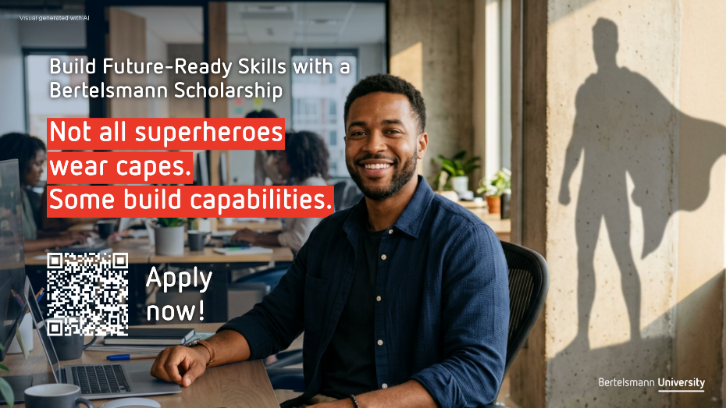


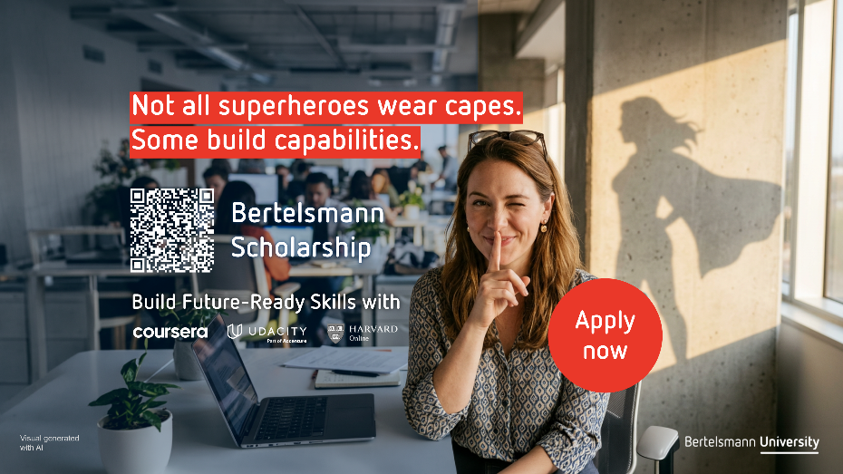
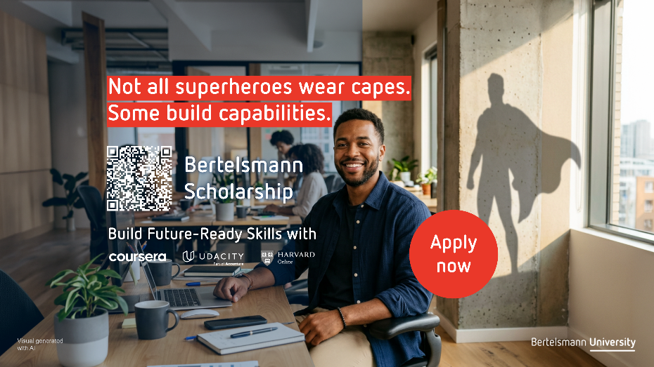
Bertelsmann Scholarship
Preview of the upcoming campaign “Not all Superheroes wear capes. Some build capabilities.”

Slide 17
Bertelsmann Scholarship and AI Leadership Upskilling
Next steps
Info and Marketing Package | September 10, 2026 | Amend our Info package to your needs.
Prepare your communication campaign | October 2025 | Think of a communication campaign to inform your employees about the new scholarship initiative.
Application Phase | October 1 – November 30, 2026 | Make employees aware that they can hand in their application for a Udacity, Coursera or Harvard Online Scholarship on the Bertelsmann University Scholarship Website.
Make your Leaders aware, that they can apply for Leading Teams in Times of AI & the AI Coach Nadia
Employee Info Session | October 8, 2026 | Make employees aware of the info session (details will follow).
Learners Phase | Start January 13, 2027 | Support and motivate your learners.
Support your graduates | Offer post graduation career support so students can apply their newly gained skills within your company.

Slide 18
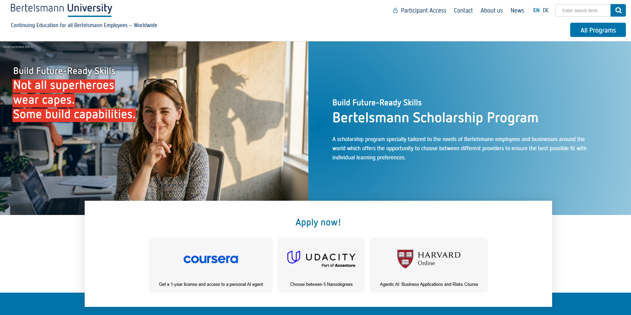
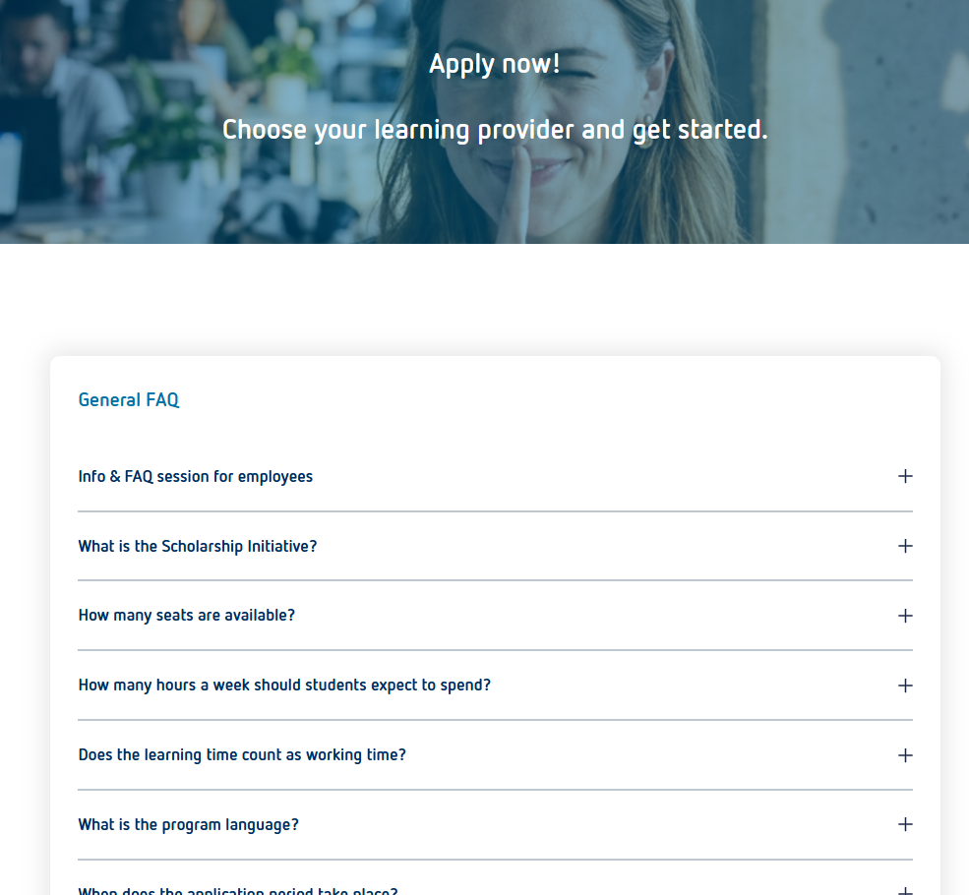
Bertelsmann Scholarship
Next steps
Visit our Scholarship Landing Page
You can find all information including a comprehensive FAQ section on our Website: https://www.bertelsmann-university.com/
scholarship-program.html
Submit your Application before November 30, 2025
Notes:
Laura

Slide 19
Bertelsmann Scholarship
Q&A
Questions?

