Slide 1
Leading in Times of AI
Master Presentation Bertelsmann University

Slide 2




Bertelsmann Scholarship & Leading in Times of AI - Complementing programs designed to strengthen organizational readiness for AI transformation
Bertelsmann Scholarship
Leading in Times of AI (LTAI & LOTAI)
In order to support transformation across all divisions and foster future-readiness of the organization, the Bertelsmann Board is financing >2000 scholarships for employees worldwide who seek personal and professional growth.
Applicants get to choose between 3 different content providers:
Coursera (Future-ready skills for AI transformation)
Udacity (AI Engineering, Agentic AI, Product Management & Cybersecurity Nanodegrees)
Harvard Online (Agentic AI Foundations)
In response to the critical role of AI leadership in realizing business value from AI, this exclusive BU leadership program package is aimed at driving AI adoption and transformation across multiple leadership levels from executives to team leads.
Content is developed and refined continuously in partnership with Coursera and Harvard Business School + varying leading institutions in the field. The curriculum reflects latest research and thought leadership on the future of organizations in the AI era.
Open to all Bertelsman Employees
Self-nomination
Open to all leadership levels (online) + for nominated participants (onsite + online)
Nomination & self-nomination
NEW: AI Agent for skill-based learning (coursera cohort)
NEW: AI Agent for skill-based learning & Personal AI coach ‘Nadia’

Slide 3
AI Skills Framework for Managers –
Target skill set, proficiency levels, definitions
Skill | Manager | Skill definition
TRANSFORMATION & PEOPLE – DEFINE
AI Value & Use Case Identification | E | Identify high-value AI opportunities and use cases, anticipate new areas for value creation, make informed decisions on which opportunities to pursue and define clear value hypotheses.
Human-AI Workflow Redesign | E | Redesign end-to-end workflows and roles around AI by decomposing work into tasks, deciding which tasks humans, AI or agents should perform, and defining business KPIs and new ways of working
Enablement, Influence & Adoption | E | Enable teams through coaching, communication, and knowledge sharing, build acceptance, provide strategic direction for AI-driven change, and support sustainable adoption in daily work.
AI LITERACY & JUDGMENT – DISCOVER
AI Fundamentals | A | Understand how AI works and its strengths and limitations and assess which tasks and problem types are suitable for AI.
Prompting & Context Design | A | Design prompts, context, instructions, and agent workflows, as well as select and orchestrate the most effective combination of prompting, agents, and automation to deliver reliable results
Critical Evaluation | A | Critically evaluate AI outputs, identify hallucinations and uncertainties, verify relevant information using appropriate methods and sources.
AI BUILD & OPERATE - DELIVER
AI Solution Design |  | Translate a prioritized AI opportunity into a clearly scoped AI solution by defining users, tasks, inputs and outputs, requirements, and verifiable acceptance criteria.
AI Solution Engineering |  | Build and integrate AI solutions and implement the designed target workflow using models, agents, APIs, automation, and other components.
AI Operations & Security |  | Ensure the reliable operation of AI solutions through monitoring, incident response, and systematic testing and evaluation throughout the lifecycle.
GOVERNANCE – DE-RISK
AI Governance & Compliance | A | Understand and apply AI, data, and compliance guidelines in daily work, ensure responsible AI use, and recognize AI risks.
B = Basic proficiency level | A = Advanced proficiency level | E = Expert proficiency level

Slide 4



Leading in Times of AI 2027 – Preparing leaders across the Group to confidently guide their teams through the opportunities and challenges of AI
Self-Nomination Track: Jan - Dec (500 seats)
Additional 2-day onsite lab in Berlin (Sept 2027): Nominated participants meet with peers and thought leaders for a deeper learning experience and and exclusive opportunity for practice and exchange
Self-directed individual learning journey to target skill set
Access to award-winning AI-powered Leadership Coach
NEW: full coursera catalog access from start to finish!
Check Skills
Define Focus
Learn
Check Progress
Personal 24/7 coach in your pocket
Supports leaders in transformation challenges and daily leadership practice
Transfer & practice human-centric skills content from online learning journey
1:1 tutor and safe space, backed by scientific coaching frameworks
Get help where your work takes place: Nadia is built into the Microsoft workspace
Native in many languages
Available with coursera learning journey or as stand-alone alternative!
Get transparency of where you stand today
Determine where your learning effort is best invested
Learn where what really matters for you
See your progress and celebrate
Shared assets
Learning goals
Turn AI potential into results. Learn how to discover valuable AI opportunities early on, redesign workflows for effective human-AI collaboration across teams. Explore how roles, responsibilities and processes can evolve sustainably when people and AI work together and how to guide your teams through this transition.
Apply AI effectively and responsibly. Understand where its opportunities and limitations lie. Critically evaluate AI generated outputs, identify high value use cases and make informed decisions about where AI can create real impact.
Drive transformation and enable change. Strengthen your ability to influence stakeholders, communicate a compelling vision, build trust and confidence around AI and help shape an environment where teams embrace new ways of working.
Nomination Track: Jan – Dec (40 nominee seats + 10 wild cards)

Slide 5
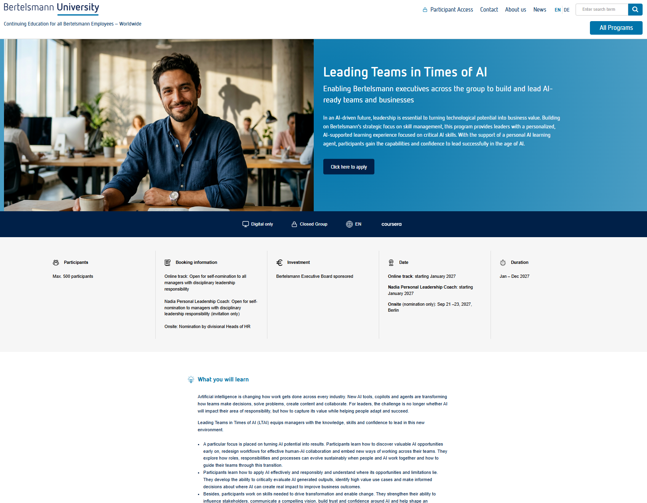
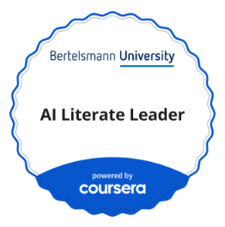
Leading Teams in Times of AI: Self-nomination track –
Program components and timeline
Online learning track
Content is based on AI skills framework for managers and tailored to personal needs with AI agent for skill-based learning
Topics include:
AI fluency
Leadership & transformation in the AI era
+ NEW: full coursera access throughout the entire online learning phase
Oct 6: Invitation e-mail to leaders (deadline Nov 30)
By Nov 30: Leaders choose full LTAI experience or Nadia AI coach standalone
500 seats | 12 months
Nadia AI Leadership Coach
12 months access to award-winning AI-powered leadership coach Nadia by Valence
24/7 coach and personal tutor in your pocket
Support leaders 1:1 in AI transformation and daily leadership challenges
Built on an AI skills framework for leadership roles
Backed by scientific coaching frameworks and built into the Microsoft workspace
Jan: Info to successful participants
New LTAI Program Website:
Details
Info material
Application form
Jan - Dec: Online learning phase and progress tracking
1000 seats | 12 months | with LTAI or stand-alone
Notes:
Nadia: As of now this is not planned as a Service, but there will be an opportunity to obtain small license amounts through our initial central purchase scope (vanilla version only, pricing tbd)

Slide 6
Back-up

Slide 7
Program announcement at a glance – Leading Teams in Times of AI 2027
In an AI-driven future, leadership is key to unlocking business value from technological potential. Success requires more than just technology – it demands rethinking the structures, culture and processes that leaders are shaping all across the organization.
This program equips leaders with the capabilities to navigate these challenges and lead with confidence in the age of AI. Bertelsmann gives managers across the Group the opportunity to benefit from a personalized learning experience that is aligned with crucial AI skills. Using an adaptive AI agent for skill-based learning, learning efforts can be focused on what really matters to the individual – for a more targeted and and impactful learning experience.
Additional 2-day onsite lab in Berlin (Sept 2027): Nominated participants meet with peers and thought leaders for a deeper learning experience and and exclusive opportunity for practice and exchange
Self-Nomination Track (500 seats)
Self-directed individual learning journey to target skill set
NEW: full coursera catalog access from start to finish!
Access to award-winning AI-powered Leadership Coach
Check Skills
Define Focus
Learn
Check Progress
Personal 24/7 coach in your pocket
Supports leaders in transformation challenges and daily leadership practice
Transfer & practice human-centric skills content from online learning journey
1:1 tutor and safe space, backed by scientific coaching frameworks
Get help where your work takes place: Nadia is built into the Microsoft workspace
Native in many languages
Available with coursera learning journey or as stand-alone alternative!
Get transparency of where you stand today
Determine where your learning effort is best invested
Learn where what really matters for you
See your progress and celebrate
Shared assets
Learning goals
Turn AI potential into results. Learn how to discover valuable AI opportunities early on, redesign workflows for effective human-AI collaboration across teams. Explore how roles, responsibilities and processes can evolve sustainably when people and AI work together and how to guide your teams through this transition.
Apply AI effectively and responsibly. Understand where its opportunities and limitations lie. Critically evaluate AI generated outputs, identify high value use cases and make informed decisions about where AI can create real impact.
Drive transformation and enable change. Strengthen your ability to influence stakeholders, communicate a compelling vision, build trust and confidence around AI and help shape an environment where teams embrace new ways of working.
Nomination Track (40 nominee seats + 10 wild cards)

